Slide 1
Stock Market Anomaly Detection
Case Study: Microsoft (MSFT)
AMMAR BUVEYDANI 210207320
MAHMOUD ABDELRAHMAN 210203303
Ali MUAAMAR ABDULJABBAR AL DUBAI 210207351
OBADA M A GHALI 210207359
ABDULRAHIM HIJAZI 220207346

Slide 2
Project Overview
Goal: Detect and predict anomalies in Microsoft stock price behavior using Machine Learning.
Methods: Data analysis, preprocessing, LSTM modeling, and visualization.
Tools: Python, TensorFlow, Keras, pandas, sklearn, Matplotlib, Seaborn.

Slide 3
Why We Use LSTM for Stock Market Anomaly Detection
Time Series Data:
Stock prices are sequential — today's price depends on yesterday's, and so on.
LSTM (Long Short-Term Memory networks) are designed specifically for time series and sequential data.
Memory Ability:
LSTMs can "remember" patterns over long periods.
This is critical for stocks, because past events (weeks/months ago) can still impact today's price.
Handle Complex Patterns:
Stock prices are noisy and non-linear.
LSTM can capture hidden trends, cyclic behaviors, and anomalies that simple models (like linear regression) would miss.
Avoids Short-Term Forgetfulness:
Traditional RNNs (Recurrent Neural Networks) suffer from vanishing gradients — they "forget" earlier information quickly.
LSTM solves this using gates (forget gate, input gate, output gate) that control what information to keep or discard.
Proven Success:
LSTM models have been successfully used in finance, stock prediction, weather forecasting, language translation, and more — it's a reliable and powerful model.

Slide 4
Data Collection
Data source: Historical Microsoft stock prices (MFT.csv).
Key fields used:
Date
Open price
Close price
Volume
Data cleaning steps:
Convert date strings to datetime
Remove commas in 'volume' and convert to integers.

Slide 5
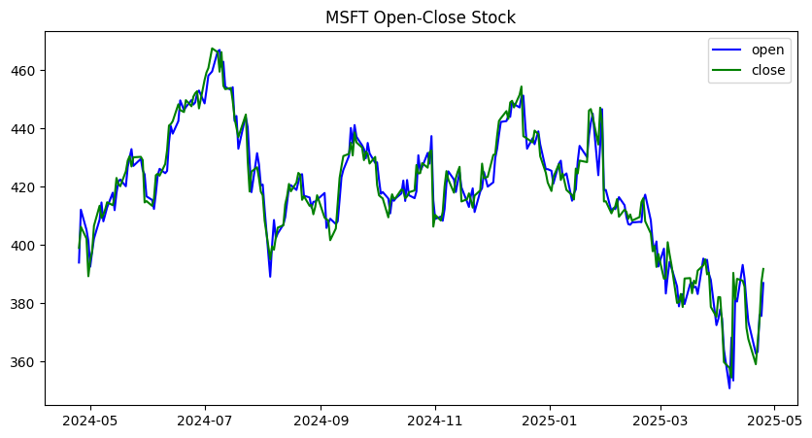
Exploratory Data Analysis
Visualized trends:
Open vs Close prices over time.
Volume movement
Insights:
Price and volume patterns highlight key market movements.

Slide 6
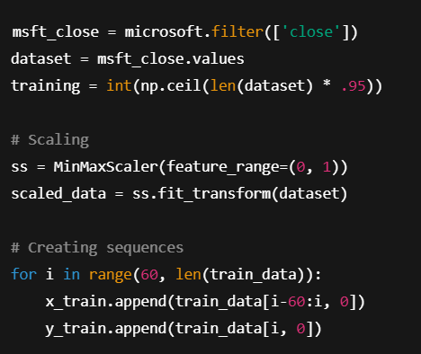
Data Preprocessing
Target feature: Closing price.
Train/Test Split:
95% training data, 5% testing.
Normalization: MinMaxScaler used to scale values between 0 and 1.
Input sequences:
Used last 60 days to predict next day's closing price.

Slide 7
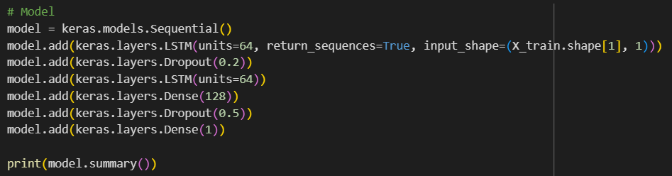
Model Architecture
Built an LSTM-based Neural Network:
LSTM layers (64 units each)
Dense layers (128 units)
Dropout layers to prevent overfitting
Loss function: Mean Absolute Error (MAE)
Optimizer: Adam

Slide 8
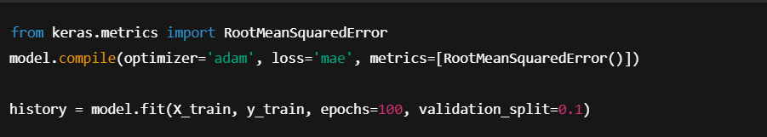
Model Training
Trained for 100 epochs with 10% validation split.
Performance Metric: Root Mean Squared Error (RMSE) used to evaluate.
Achieved good convergence with low validation loss.

Slide 9
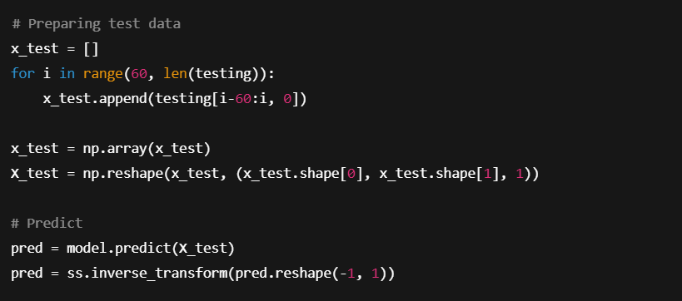
Model Testing & Prediction
Created test sequences from unseen data.
Predicted closing prices compared with real data.
Inverse Transformation: Scaled predictions back to original price values.

Slide 10
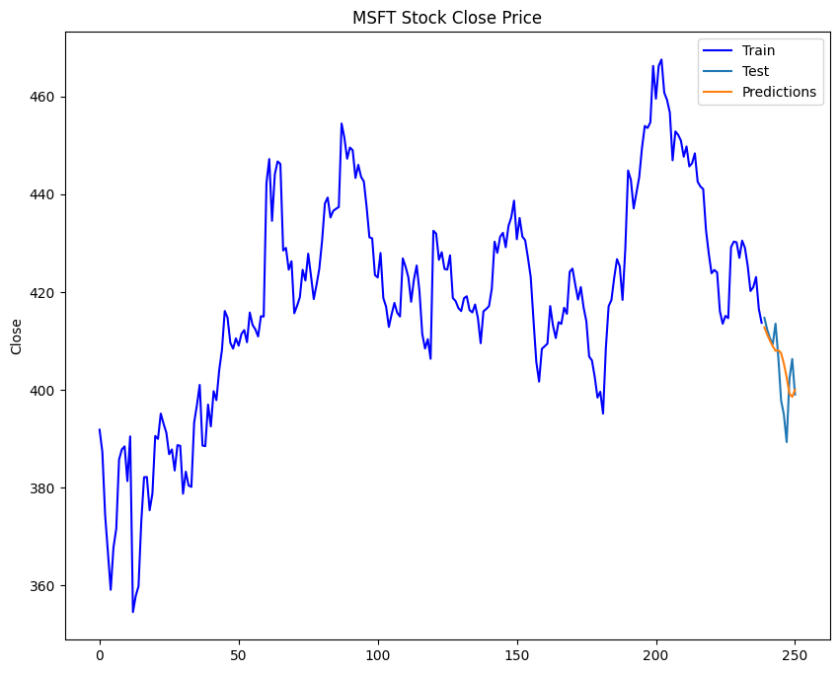
Results Visualization
Plotted:
Training Data
Testing Data
Model Predictions
Findings:
Predictions closely follow real closing prices.
Detected points of deviation/anomalies.

Slide 11
Conclusion
Successfully detected anomalies and trends in Microsoft stock prices.
LSTM models are effective for time series prediction tasks.
Future improvements:
Try other architectures (GRU, Transformer models).
Include more features (Volume, High, Low).
Detect real-time anomalies for live trading systems.

